Slide 1
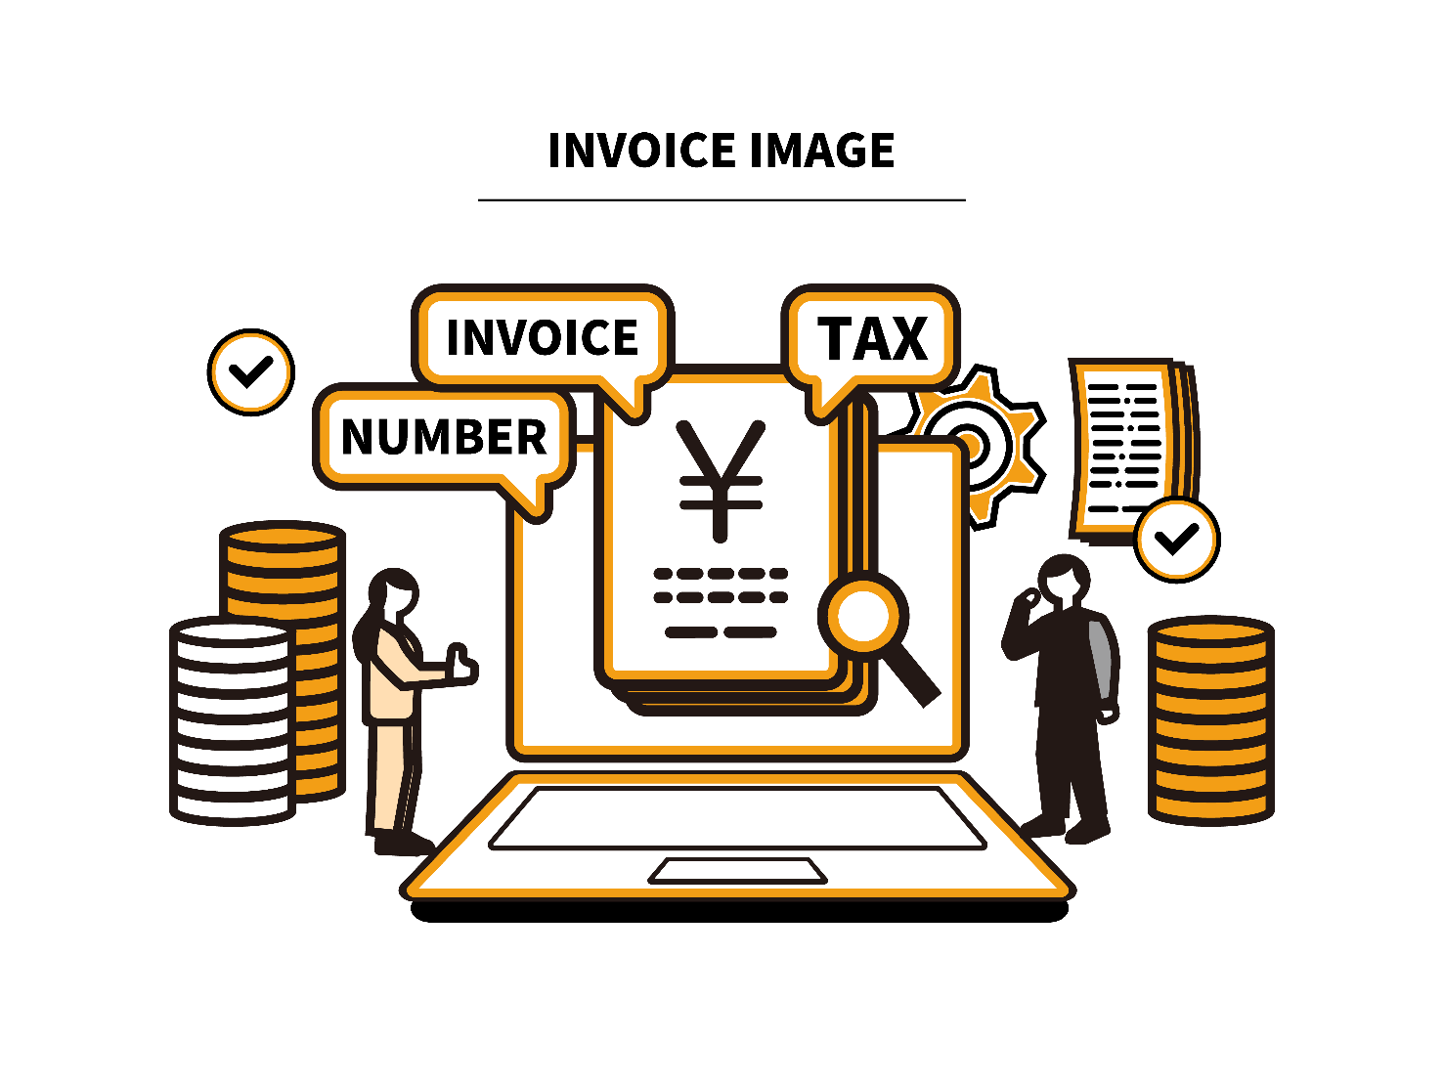
Overview of Japan’s Consumption Tax
Impact on your business
TGN Soleil
Accounting Firm

Slide 2
Structure of CTax
Multiple tax rates
10% or 8%
Ⅰ-１
From October 1st 2019
importing
manufacturing
wholesaling
retailing
consumer
Material
Customs
★
Cost 12,000
Cost
15,000
Cost
20,000
Cost
25,000
Profit 3,000
Consumption
30,000
CTax
deductible
Profit 5,000
1,200
CTax
payable
CTax
deductible
Profit 5,000
1,500
1,500
Profit 5,000
CTax
payable
CTax
deductible
2,000
2,000
CTax
payable
CTax
deductible
2,500
2,500
CTax
payable
CTax
deductible
3,000
3,000
1,200
＋
300
＋
500
＋
500
＋
500
＝ 3,000
The amount of CTax payment of each business
The amount of the bill for the end-user

Slide 3
Multiple Consumption Tax Rate
Ⅰ-２
Ⅰ-3
８％
Reduced Tax rate
Standard Tax rate
10％
Foods and Drinks
Restaurant
Newspapers
Alcohol
Foods & Drinks
Others
News
Take out
Restaurant
Beer
Wine
Newspaper
Pharmaceutical/
medicated product
Water

Slide 4
Qualified Invoice Issuers
Ⅰ-３
The multiple consumption tax rate system started.
2019
2021
2023
1 Oct
1 Apr
1 Oct
1 Oct
Registration Number
invoice
Rate-classified invoice method
Qualified invoice method
Obligation to Indicate the total price
to consumers

Slide 5
Application to become a Qualified Invoice Issuer
Ⅰ-４
Qualified Invoice is necessary for tax credit of JCT calculation.
A non-taxpaying business cannot become a Qualified Invoice Issuer.
No business loss due to JCT issues
vs.
Tax exemption benefit

Slide 6
Tax base
Ⅱ-１
Taxable sales
1
Domestic transactions in Japan
（ⅰ） the sales or lease of an asset or
the supply of services in Japan
（ⅱ） when carried out as part of a business
（ⅲ） with compensation
2
Imports of goods into Japan
Removing the imported goods from bounded warehouse.
Non-residents without a fixed place of business in Japan must appoint a tax representative to handle Ctax administration

Slide 7
Tax base
Ⅱ-２
The main non-taxable or zero-rated transaction
：Ctax does not apply to the Following items
sales or leases of land
Certain services for the handicapped
insurance premiums
services carried out by the central/local government
medical care, certain education related services and social welfare services
rental of housing
services performed in an international context (transaction, communication services.)
exported goods and services
goods purchased from tax-free shopping for non-residents
Other items because of political reasons

Slide 8
Filing and payments
Ⅲ-１
Filing and payments annually.
Due within 2 months of the end of a corporation’s
fiscal year.
For individuals , due by March 31 of the year following
the end of calendar year.
The interim return is required depending on the amount
paid as CTax for the previous year.
（The interim payments are required at the semi-annual
basis , quarterly basis or monthly basis.)

Slide 9
Filing and payments
～taxpayer
Ⅲ-２
2020
2021
2022
2023
1/1
12/31
1/1
6/30
12/31
1/1
12/31
2/28
12/31
the base period
the specified period
the current year
over JPY 10M
(€69000）
taxpayer
taxable sales
due date for
filing and payment
taxable sales
and total amount of
salary payment
over
JPY 10M
taxpayer
JPY 10M
or less
non-taxpayer
Newly established companies
taxpayer
Its paid-in capital at the beginning of the fiscal year is JPY 10M or more

Slide 10
Ctax on cross-border supplies of services
Ⅳ-１
National border
Japan
Abroad
Domestic
business
Foreign
business
Electronic commerce , such as supplies
of digital books ,music , and
advertisements , as well as cloud services
Electronic commerce , such as supplies
of digital books ,music , and
advertisements , as well as cloud services
Co
CTax is levied.
Domestic
consumers/business

Slide 11
Rule for “B2B”
~Reverse Charge mechanism
Ⅳ-２
Japan
Customers
Abroad
Suppliers
National border
B
Service
B
Clear that they are
Business customers
No tax payment
Price 100
Ctax -
Total 100

Slide 12
Rule for “B2C”
~Foreign suppliers filing system
Ⅳ-３
Japan
Customers
Abroad
Suppliers
National border
C
Service
B
tax payment
Not Clear that they are
Business customers
Price 100
Ctax 10
Total 110
◎ Registration of foreign suppliers

Slide 13
Q&A (1)
Ⅳ-４
(Q) EU business “X” distributes the game contents to their users in the world.
Should they pay C-tax for sales in Japan?
Yes, it is B2C transaction just for the Japanese users in Japan. If they have an obligation as a C-tax payer, they should pay it. As “X” is a foreign company, it has to appoint a tax administrator to make a tax return.

Slide 14
Q&A (2)
Ⅳ-５
(Q) EU business “X” holds an asset in Japan and outsourced its management. “X” received an invoice which included C-tax”.
Should “X” pay it?
Yes. Services provided to non-resident will be treated as export transactions except provision of services only beneficial in Japan. The services of management of assets in Japan is one of examples.

Slide 15
Q&A (3)
Ⅳ-６
(Q) EU business “X” went to Japan in order to purchase and
export some goods from Japan. “X” paid JCT at the payment to the Japanese vendors.
Is it possible to get the JCT refund?
Yes.
But “X” must be a JCT tax payer.
If “X” has no branch nor subsidiary company in Japan, it has
no obligation to pay corporate taxes. But it can become JCT
tax payer.

Slide 16
THANK
YOU!

